Slide 1
Tendency to select rocks from the categories where they lack knowledge
Grid Location (shift)
Tendency to repeatedly select rocks from the same category
Notes:
The relationship between the rock selection pattern during training and the overall test performance
The exact grid locations are not as meaningful as the shift in the grid location between training trials as the training rocks are sampled and arranged differently for different subjects.

Slide 2
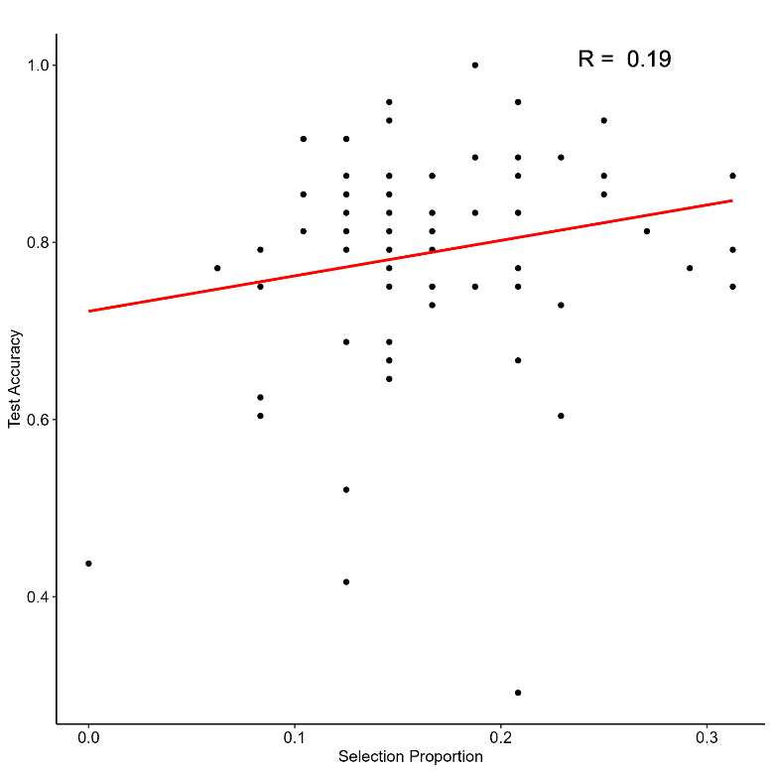
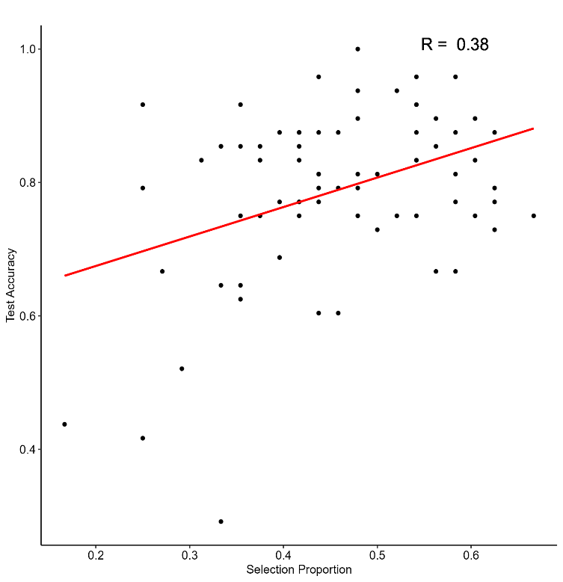
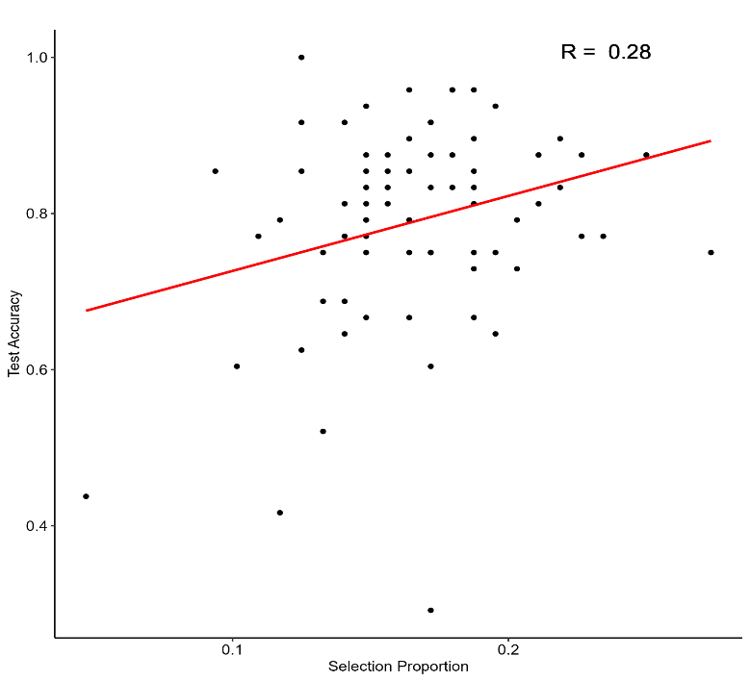
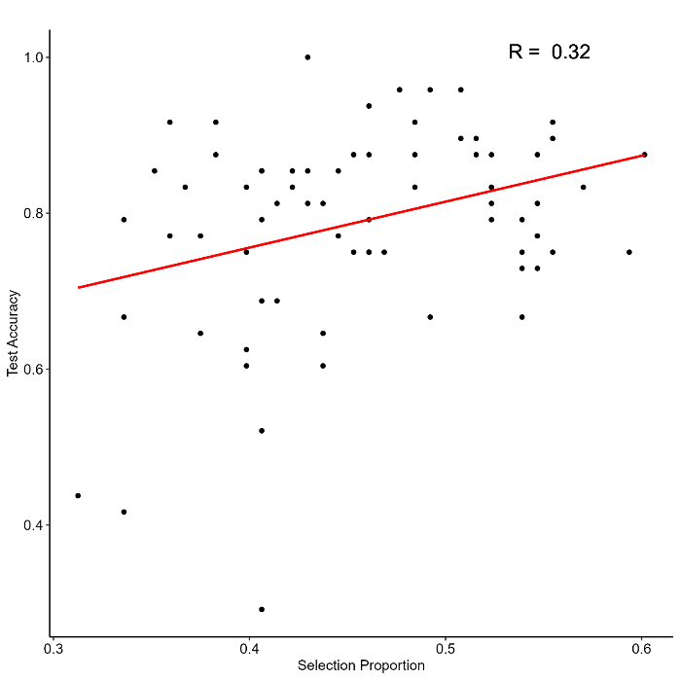
How to compute x value:
1. compute the d-primes for each category in test blocks 1-8,
d’(A) = Pr(resp = A| cat = A) – Pr(resp = A| cat != A)
2. compute the mean proportions of the rocks selected over training blocks 2-9/4-6 that are from the categories with the lowest 1/3 d primes in the prior test block (least well-learned)
Lowest category
Lowest three categories
Mid Blocks
Full Blocks
How to compute y value:
1. Average the overall proportions of correct responses over the last 3 test blocks.
Notes:
X value: a measure of the tendency for each subject to focus on the less well-learned categories:
Y value: a proxy measure of test performance after adequate amount of training

Slide 3
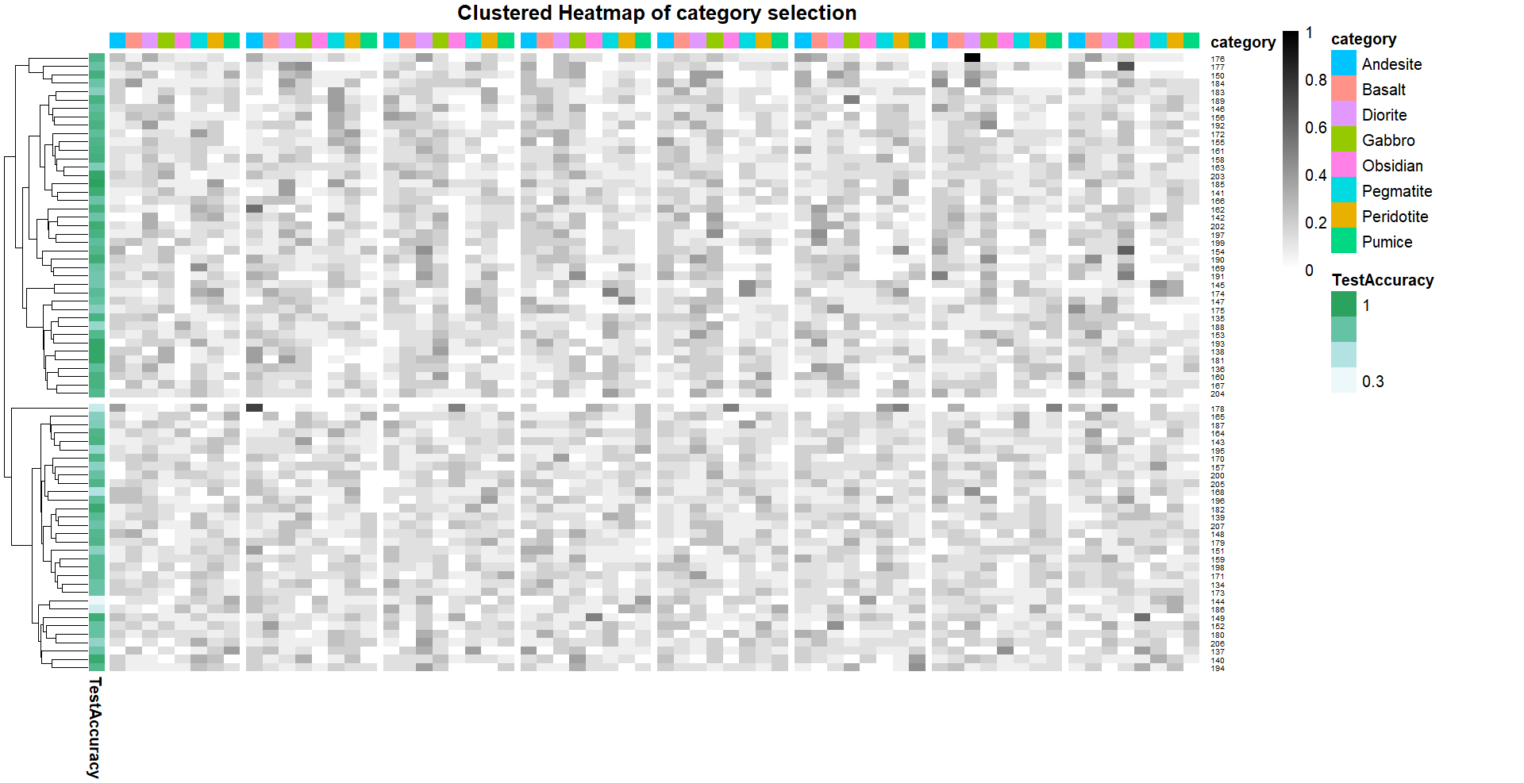
Notes:
The proportions of rock selection across categories and blocks (2-9).
HAC (distance metric: Euclidean distance; linkage method: ward’s method that minimizes within-cluster variance)
Theoretically, subjects in the same major cluster have selection-proportion patterns more similar to one another than to subjects in the other cluster.
It seems like the test accuracies for subjects in the upper cluster are generally higher than for subjects in the lower cluster.

Slide 4
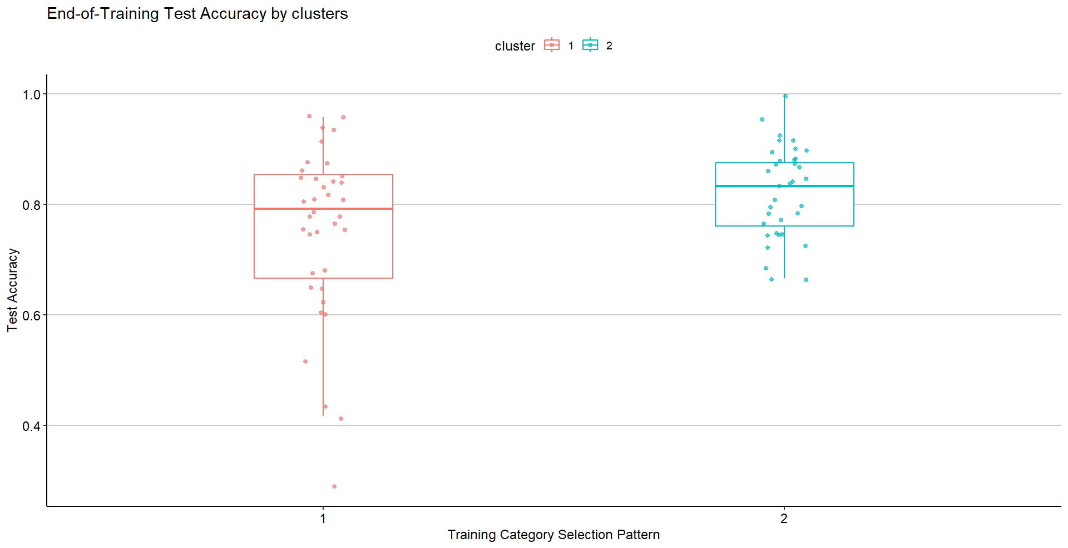
Notes:
The thick line in the middle of the box represents the median.

Slide 5
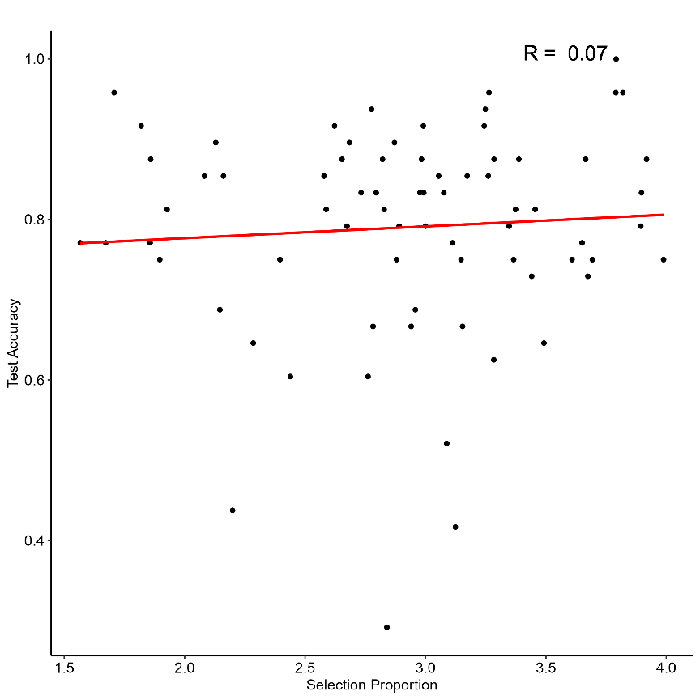
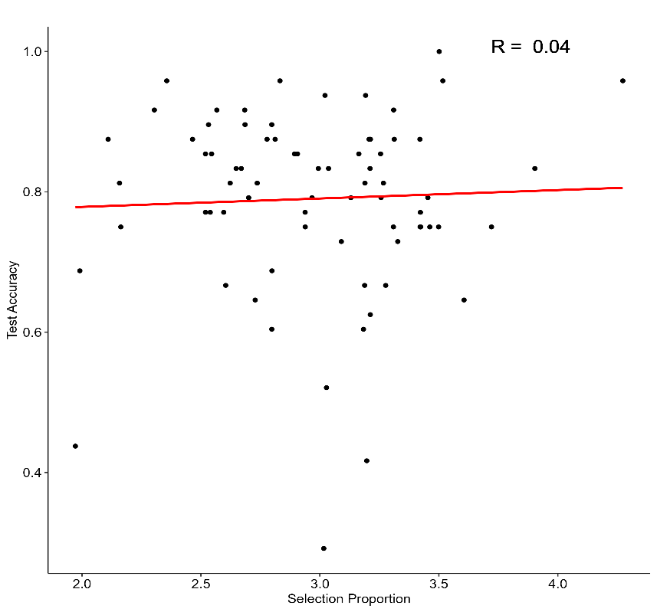
How to compute x value:
1. compute the Euclidean distances between the grid locations of the rock selected on all adjacent training trials
2. average the trial-level distances over blocks 1-9 or blocks 4-6
Mid Blocks
Full Blocks
How to compute y value:
1. Average the overall proportions of correct responses over the last 3 test blocks.
Notes:
X value: the extent to which subjects stay focused on the same region in the grid

Slide 6
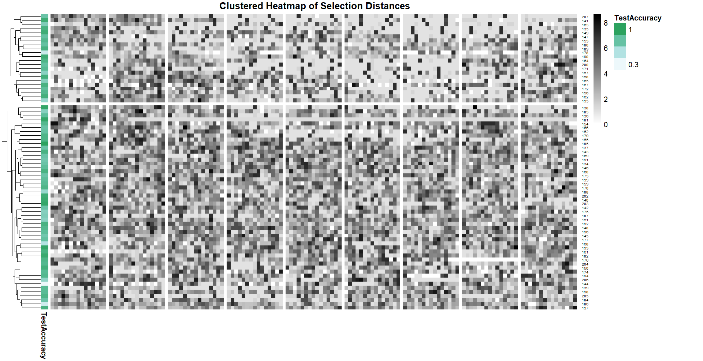
Notes:
Each row represents the selection distances concatenated across trials and blocks
The white cells indicate that the subject selects the same rock as in the last trial.

Slide 7
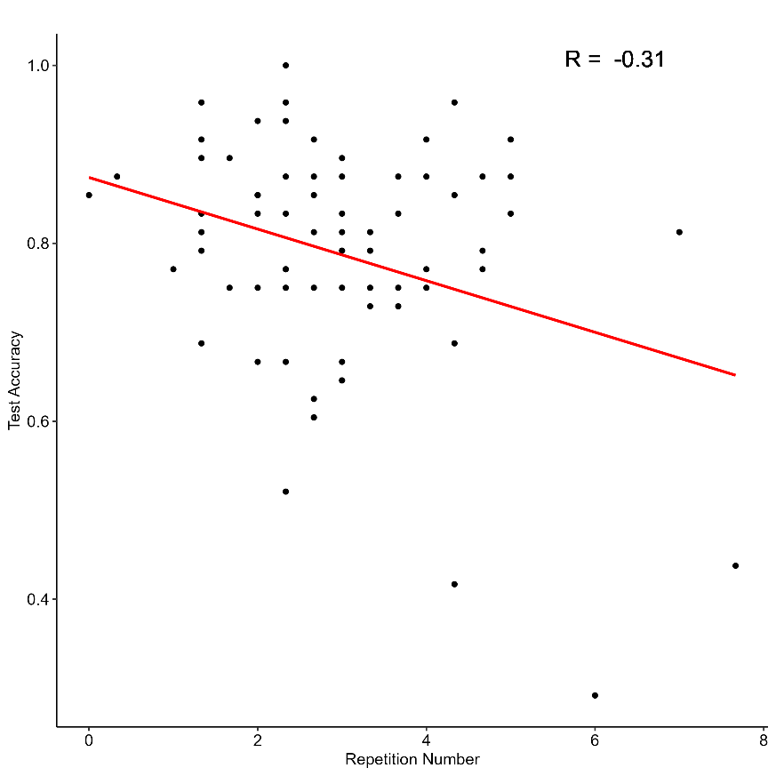
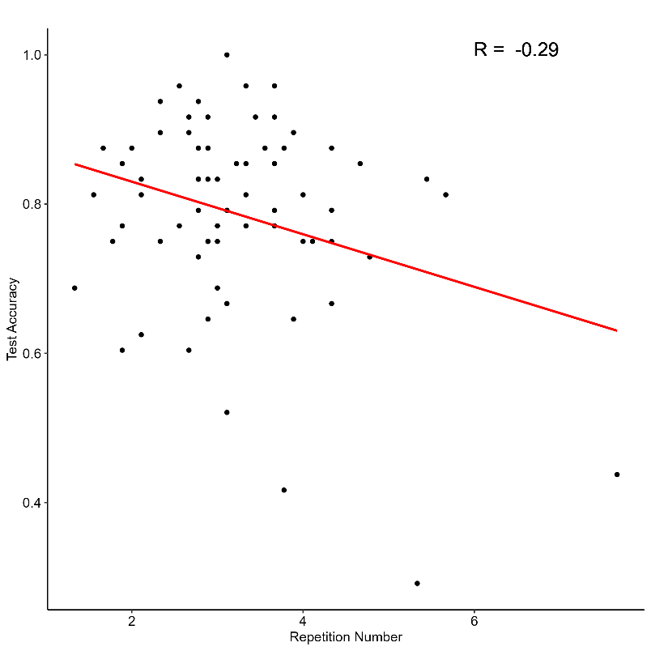
How to compute x value:
1. compute the total number of trials in which a rock from the same category as in the last trial is selected for each training block
2. average the numbers of repeating trials over blocks 1-9 or blocks 4-6
Mid Blocks
Full Blocks
How to compute y value:
1. Average the overall proportions of correct responses over the last 3 test blocks.
Notes:
X value: the tendency to repeatedly sample rocks from the same category.
(I realize that subjects may not know a priori which category different rocks belong to).

Slide 8
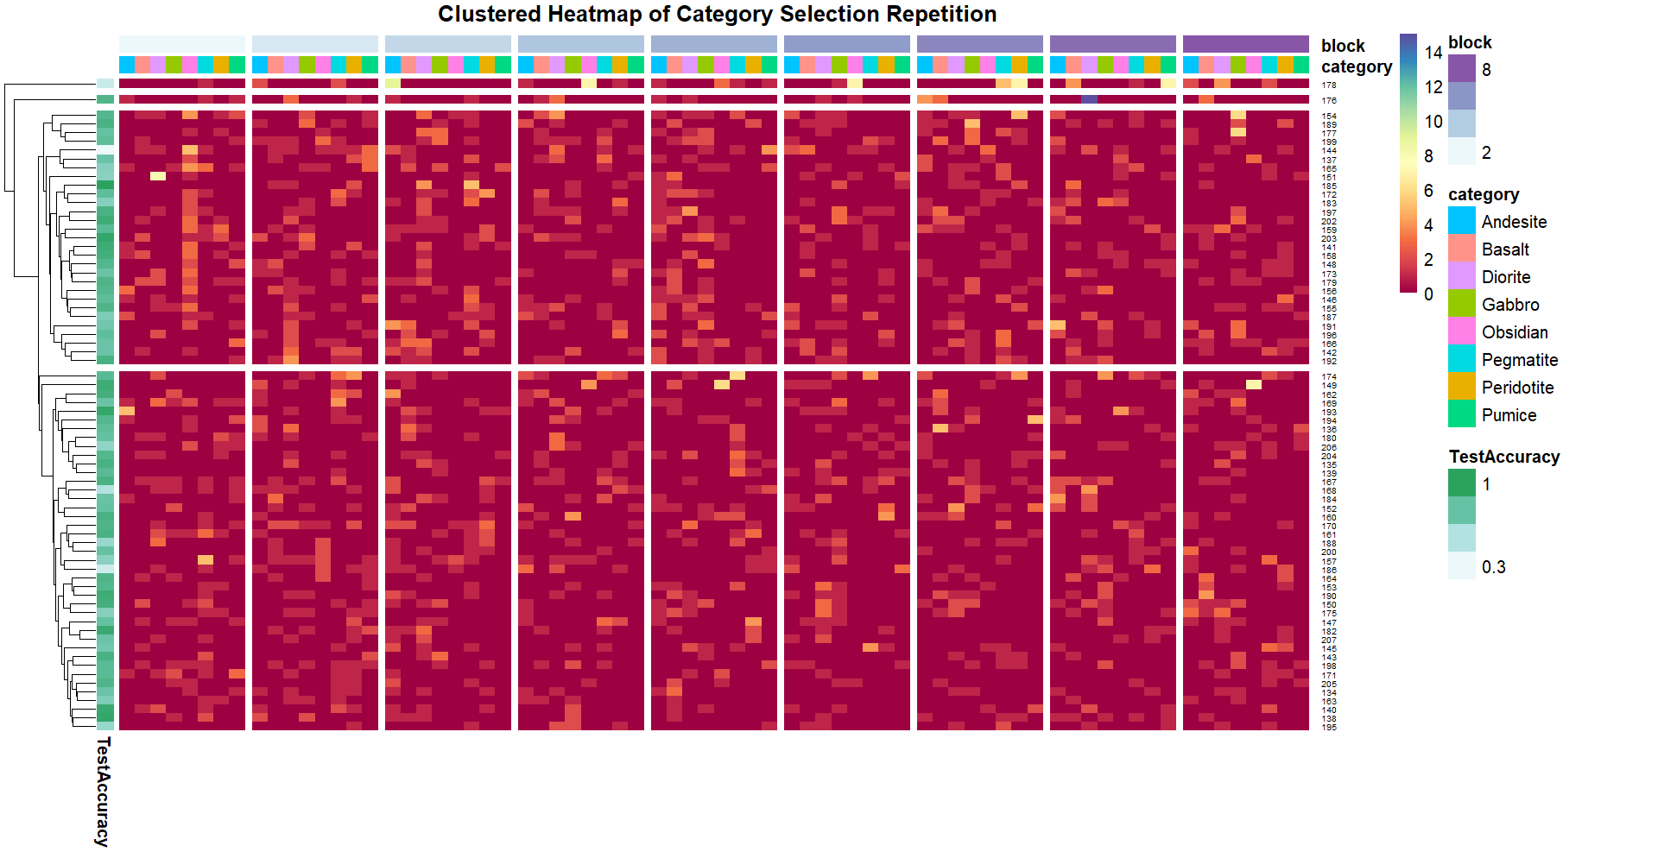
Notes:
A different color scale is used to accentuate the difference between smaller values.

Slide 9
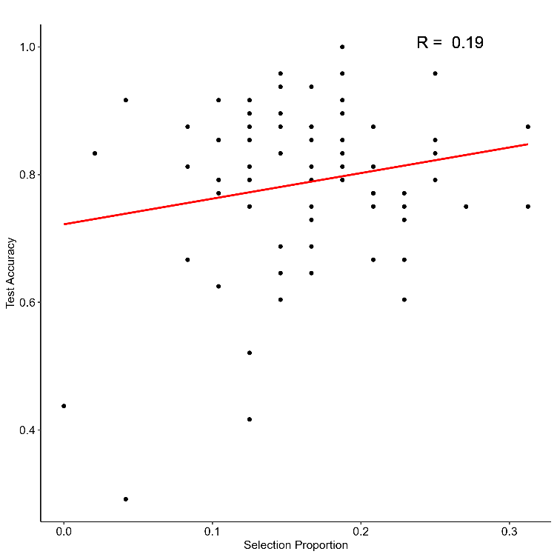
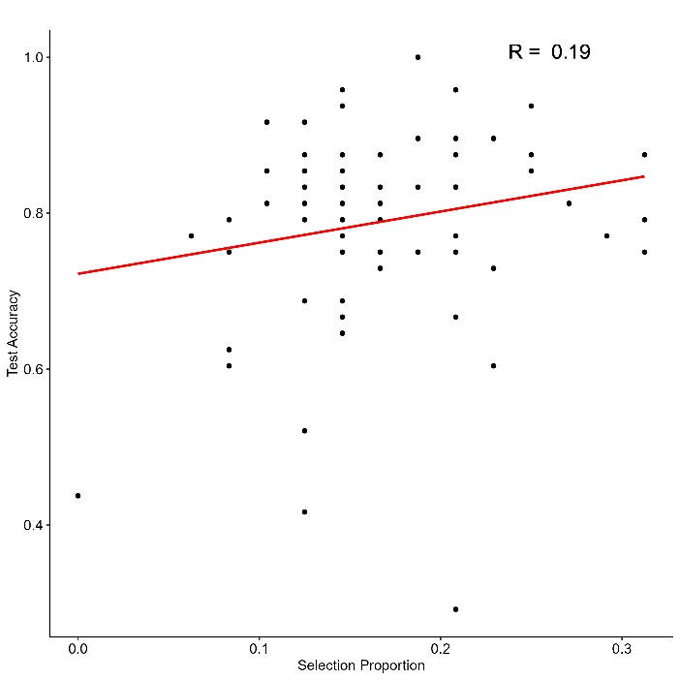
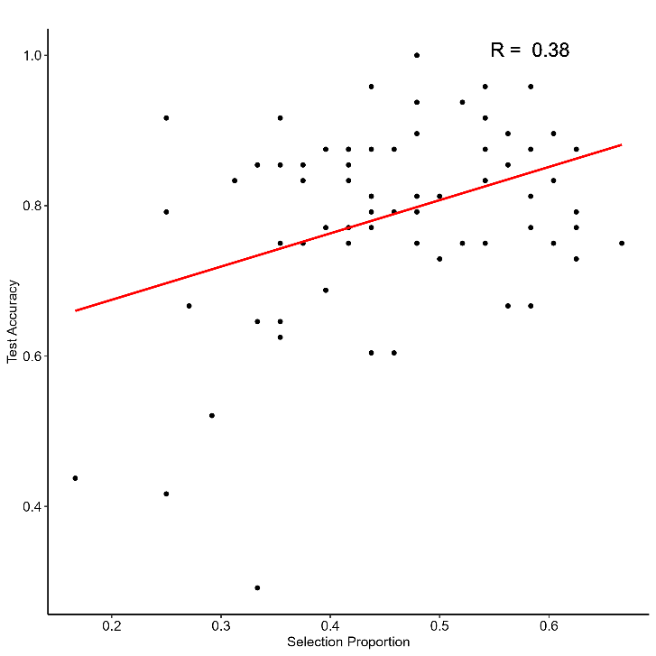
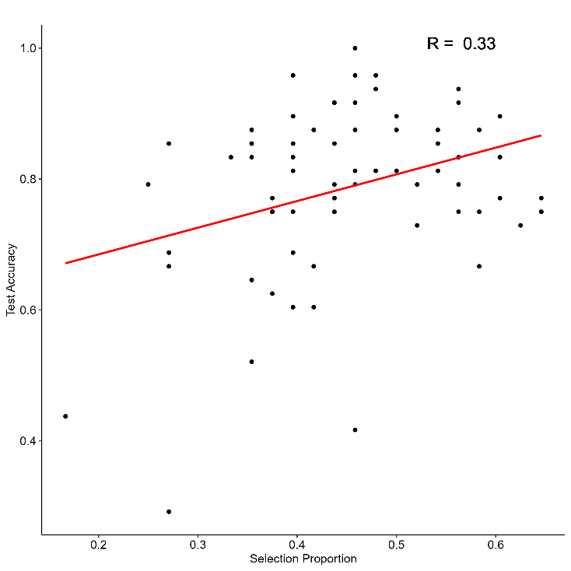
Sum FA
Max FA
Lowest 1
Lowest 3

